Slide 1
CoreSource Broker Summit
Tuesday, June 21
Loews Hotel | Chicago, IL
Notes:
Welcome guests to Chicago and thank them for joining us.

Slide 2
Key Discussion Topics
Introductions and Company Overview | Ben Frisch Bob Wolfkiel
CoreSource Value Proposition and Strategic Objectives | Steve Horvath
2016 Key Initiatives
Consumer – Focused Advocacy and Engagement | Joanne McGowan
New Analytics Resources | Amy Bloedorn
New Innovative Member Solutions | Clare Smith
Market Insights Collaboration | Kim Fiori
Notes:
Outline the agenda

Slide 3
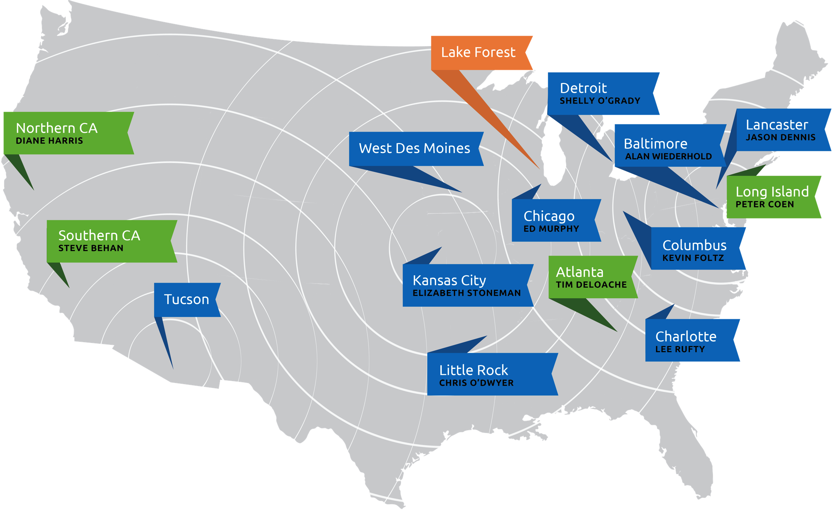
The CoreSource Team
Corporate Headquarters
Regional Offices
Remote Offices
Notes:
Introduce CS team members
Central Region
Northeast Region
West Region
Corporate HQ

Slide 4
CoreSource Central
Kim Fiori Regional President | Detroit, MI
Tim DeLoache Sales Executive | Atlanta, GA | Chris O’Dwyer Sales Executive | Little Rock, AR
Kevin Foltz Sales Executive | Columbus, OH | Shelly O’Grady Sales Executive | Detroit, MI
Lee Rufty Sales Executive | Charlotte, NC
Notes:
For purposes of printing the presentation

Slide 5
CoreSource Northeast
Bob Wolfkiel Regional President | Lancaster, PA
Pete Coen Sales Executive | Long Island, NY | Alan Wiederhold Sales Executive | Baltimore, MD
Jason Dennis Sales Executive | Lancaster, PA
Notes:
For purposes of printing the presentation

Slide 6
CoreSource West
Ben Frisch Regional President | Kansas City, KS
Steve Behan Sales Executive | Southern CA | Ed Murphy Sales Executive | Chicago, IL
Diane Harris Sales Executive | Northern CA | Elizabeth Stoneman Sales Executive | Kansas City, KS
Notes:
For purposes of printing the presentation

Slide 7
CoreSource Corporate
Amy Bloedorn Senior Director, Data Analytics | Dave Parrish VP Strategic Relationships & Sales Support
Pam Cowan Senior Director, Product Development | Erin Polis Marketing Director
Steve Horvath VP Product & Marketing Strategies | Megan Powers Marketing Administrator
Dina Matson AVP Corporate Communications | Lloyd Sarrel Chief Operating Officer
Joanne McGowan VP Customer Experience & Strategy Execution | Clare Smith VP & Chief Financial Officer
Notes:
For purposes of printing the presentation

Slide 8
CoreSource: The Nation’s Largest Independent Benefits Administrator
Business Insurance ranks CoreSource as the nation’s 3rd largest health benefits administrator
Part of the Trustmark Companies, an A- rated mutual insurance company with over $2B in assets
Serving over 1.1M members
Over 11M claims processed totaling $8B
Clients ranging in size from 100 – 65,000 lives
Notes:
Facts about CS

Slide 9
An Integral Part of a Larger Enterprise
Four business units with a shared mission to increase well-being through better health and greater financial security.
Notes:
Introduction of TMK BU’s

Slide 10
Trustmark Companies
Trustmark Companies Overview
(Corp. Comm. will provide a slide with video embedded)
Notes:
Show 1:24 of TMK video

